Slide 1

Chosen Idea from Ideation Derby
Team Seven: Nathan Anthony, Fanta Cisse, Kismet Crossdale, Kamsi Dozie-Obele, Hayden Fuller, Jameson Giannattasio

Slide 2

Two Subteams, Two Ideas
Subteam A: Kismet, Jameson, Hayden
Proposed solution concept
Rotational wiper powered by AC source with an efficiency sensor
Benefits of concept
Detects debris effectively
Efficiently removes all debris to increase energy output
Minimal parts to keep simplistic, affordable, and easily installable
Subteam B: Nate, Fanta, Kamsi
Proposed solution concept
Motor free air compressor
Benefits of concept
Low cost power (Infrared radiation from sun)
Compact
Lightweight

Slide 3
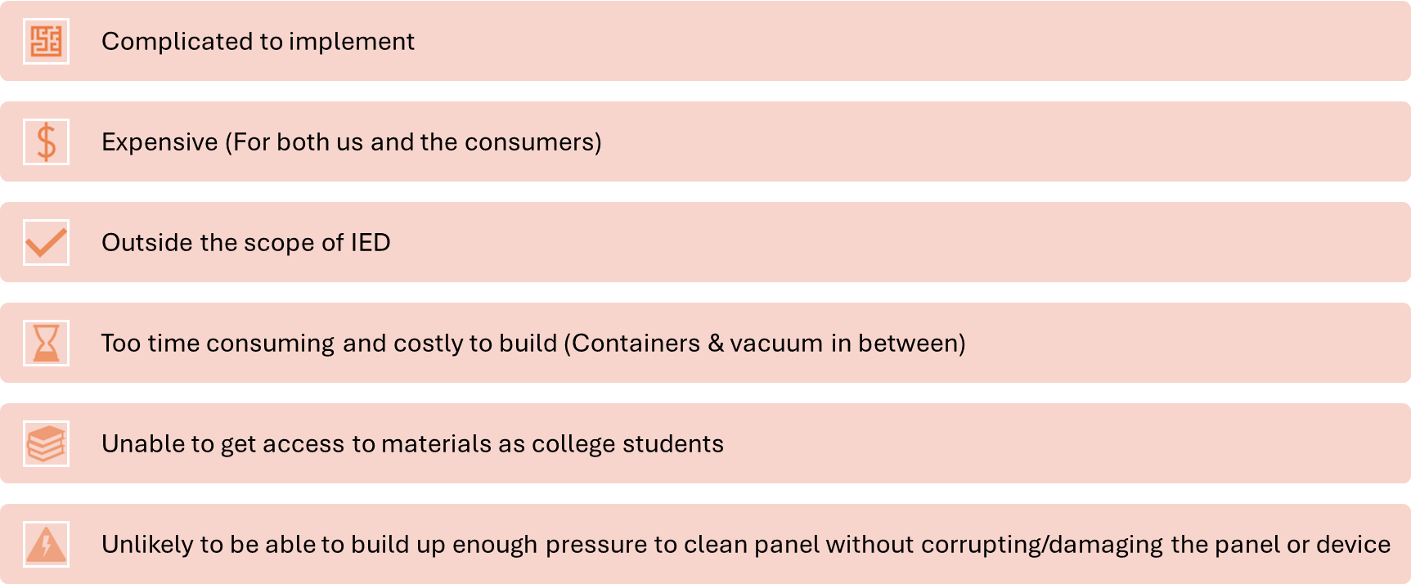
Why we didn’t choose the compressed air

Slide 4
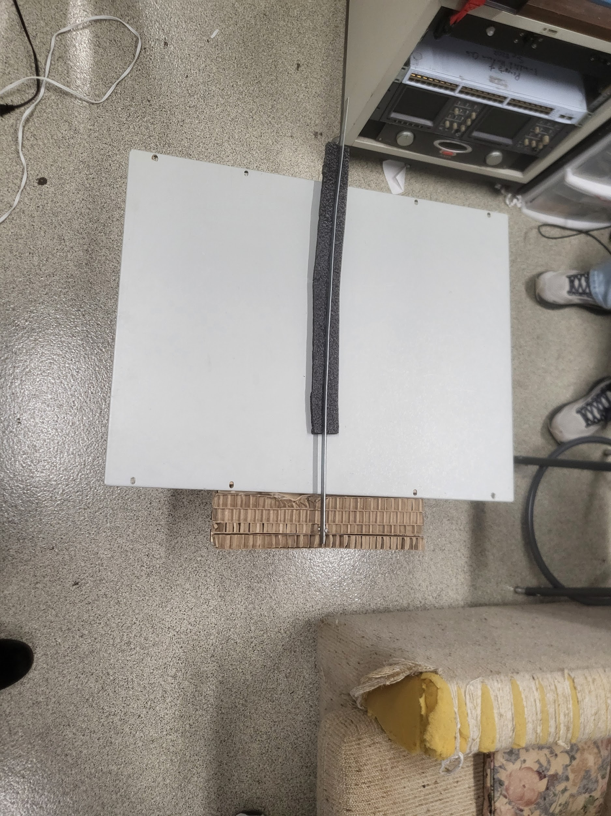




Why we choose the Wiper
Cost-Effective (Paramount)
Easy to implement
In the scope of this class
Less parts/steps to build it
We have a lot more progressive ideas specifically for the wiper
Highest score in evaluations

Slide 5

Things to Improve/Develop Further
Find different way to implement mounting apparatus
Board underneath may be hard for the average family to install under a solar panel
Where the debris that has been cleaned off from the solar panel will go/be stored
Wiper material
Figure out motor type, electronics, & wiring to AC Power
Wiper motion (180 degrees rotational motion, spinning brush arm, linear motion, etc.)
How much energy and time the wiper will take to be used once (will it “eat up” a lot of energy generated by the solar panel?)
How the material on blade will interact with the panel (i.e. not too much friction)

Slide 6
Relations to DEI and Professional/Societal Factors
Simplistic:
Minimal amount of parts to ensure easy assembly
Wiper, Motor, Mounting Apparatus, Sensor, Wiring
Affordable:
Keeps costs low with the materials implemented to allow for users to purchase the product in poorer locations
Accessibility:
Lightweight with simple materials that can be produced in regions for targeted users
Energy:
Will provide more consistent energy to users in areas where condition of electrical grid is not the most stable.

Slide 7

THANKS FOR LISTENING!
QUESTIONS?

